Slide 1
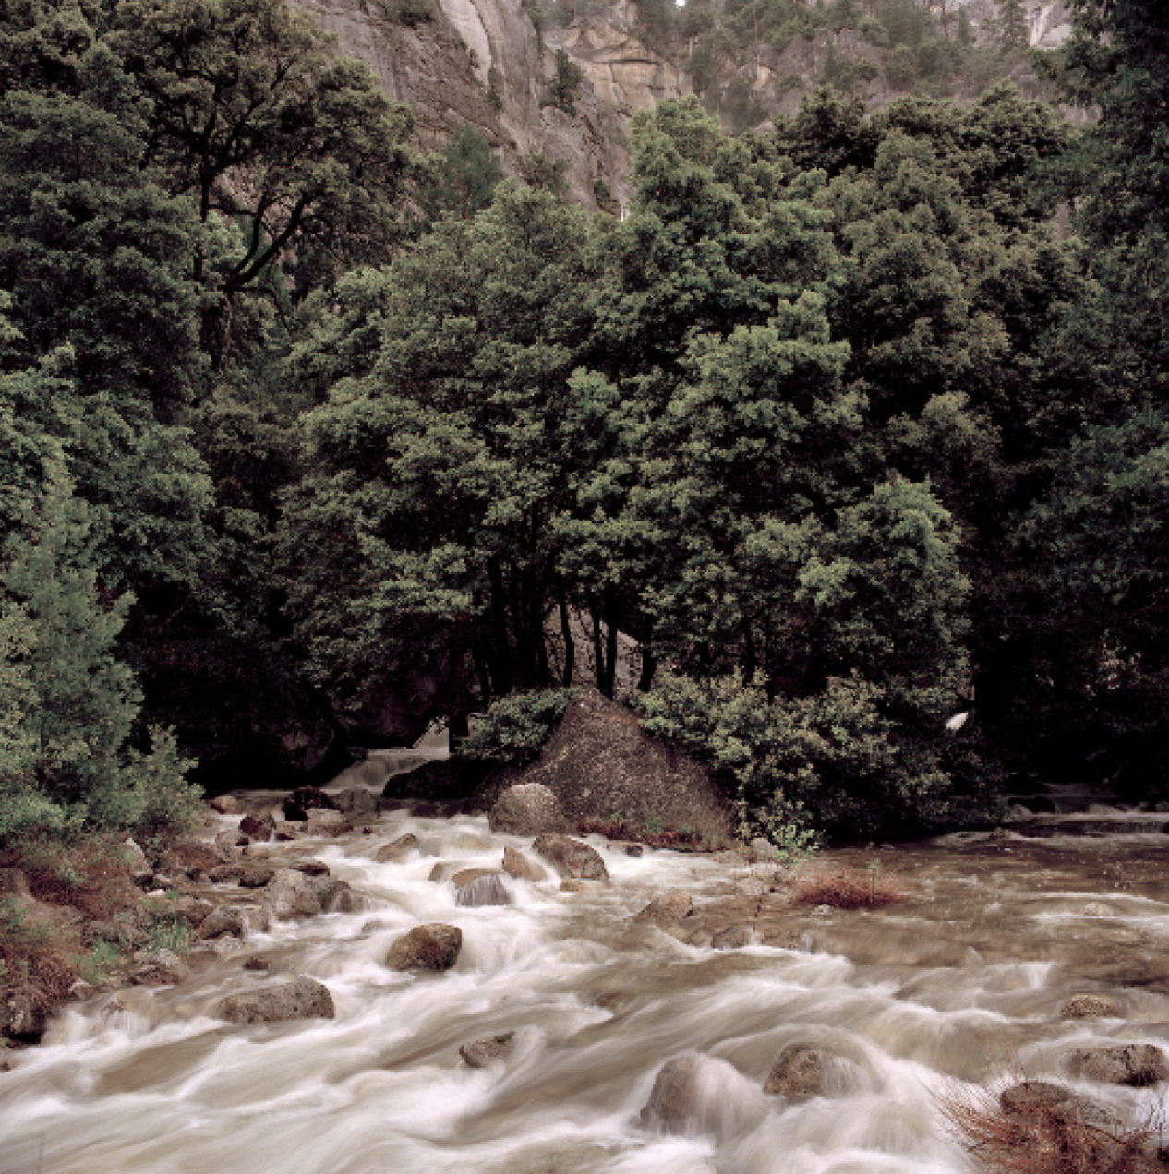
Flood-MAR Update Presentation
Prepared by: Team #25
Matthew Chen, Ava Lancaster, Lily Langes, and Fatima Segoviano
Notes:
Good afternoon, my team and I will be updating you on our metrics, methodology, and lastly our graphical results from this project thus far.

Slide 2
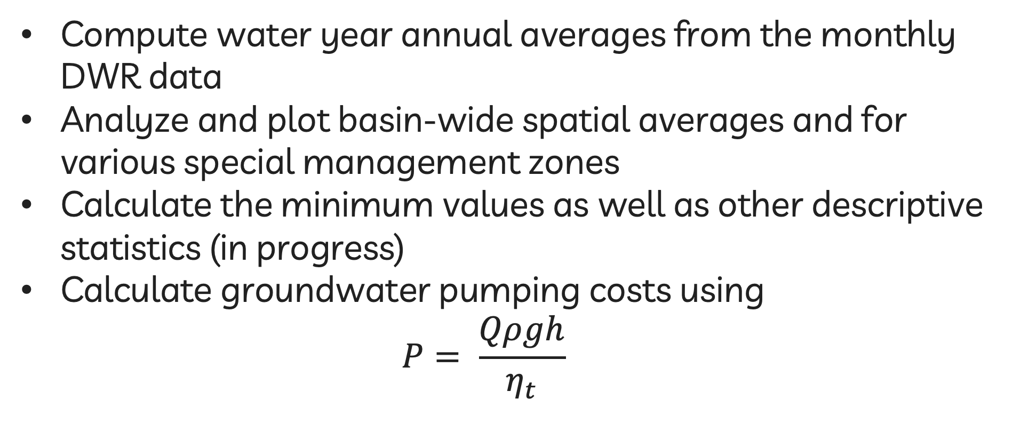
Methodology
Notes:
Pump hydraulic power equation

Slide 3
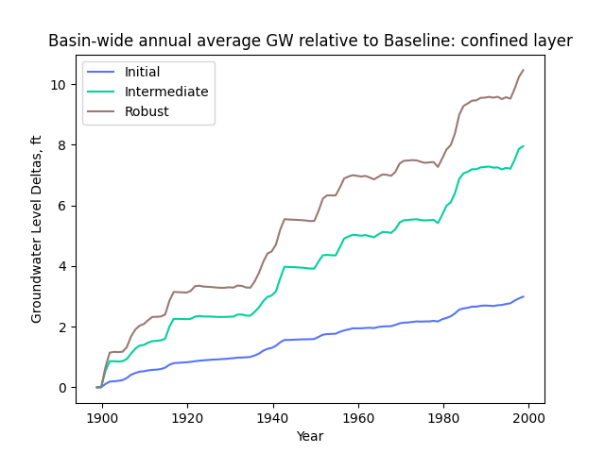
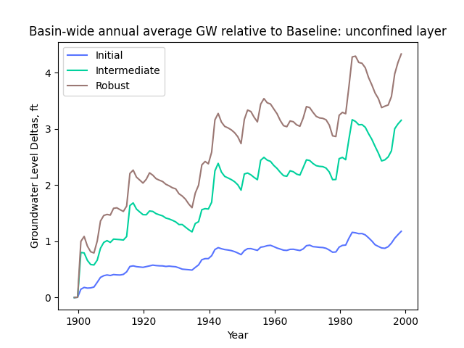
Metric: Water Supply Reliability

Slide 4
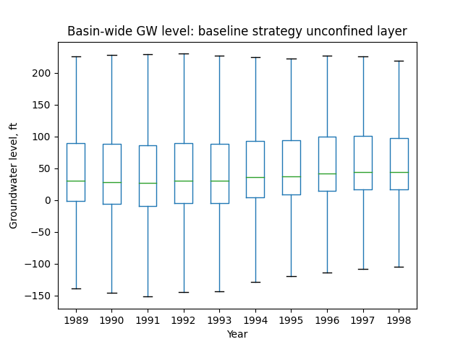
Notes:
We recognize that the mean doesnt tell us the whole story so we decided to create this box plot of the last 10 years.

Slide 5
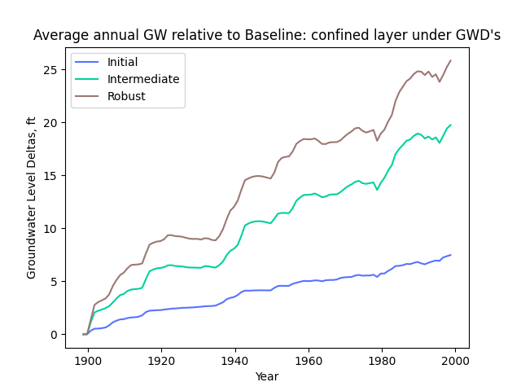
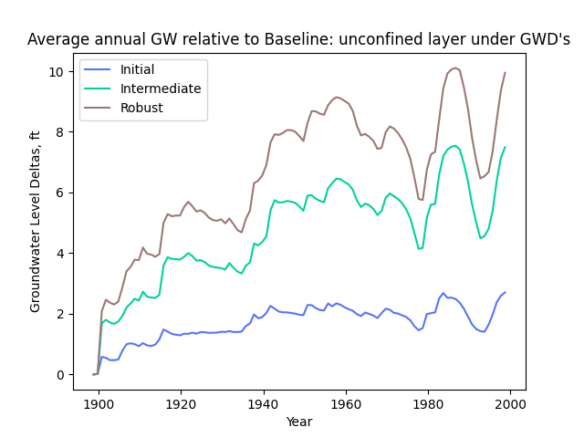
Metric: Groundwater Dependent Communities
Notes:
For the groundwater dependent communities (communities that rely on groundwater) in both confined and unconfined aquifers we can see a similar trend as before. The robust scenario is the most effective strategy. The confined aquifer has a steeper slope to it while the unconfined has more fluctuations due to the wet and dry years.

Slide 6
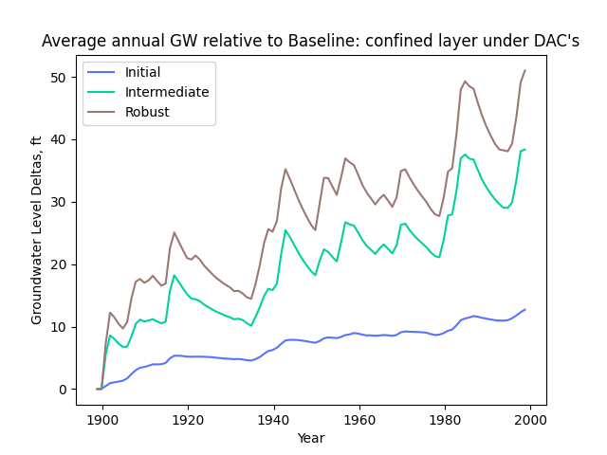
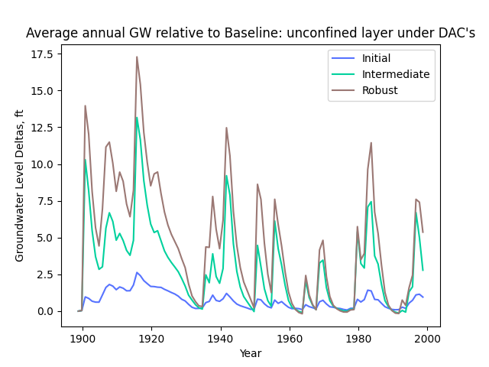
Metric: Disadvantaged Communities
Notes:
For disadvantaged communities (are those who have an annual median household income less than 80% of the Statewide annual) variability for the unconfined layers can be connected to dry seasons where all the scenarios would be less effective but overall robust is the better scario for both cases
add the values for

Slide 7
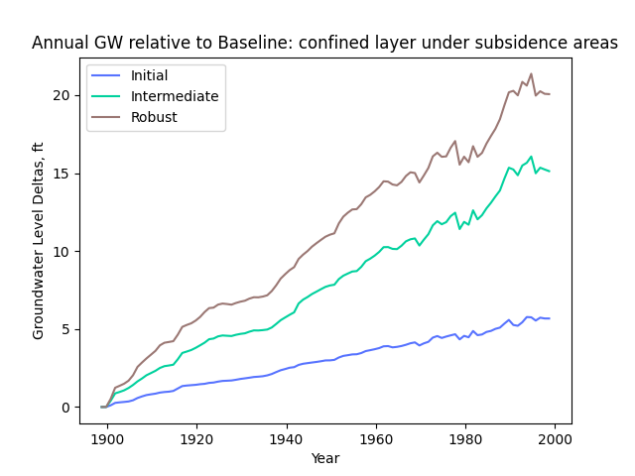
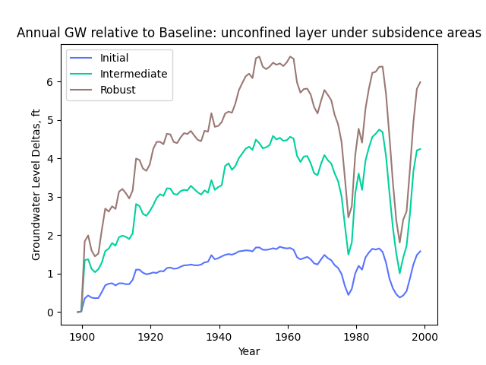
Metric: Subsidence Zones

Slide 8
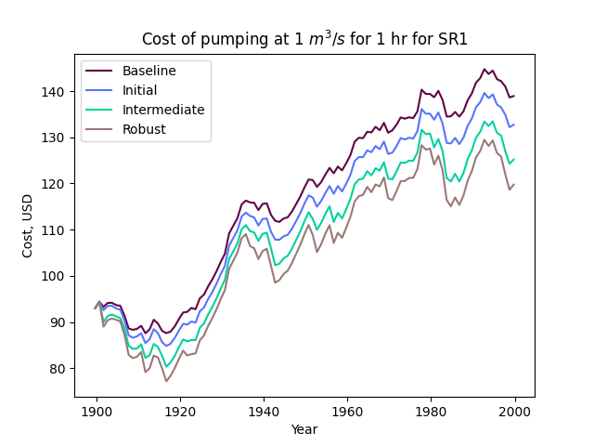
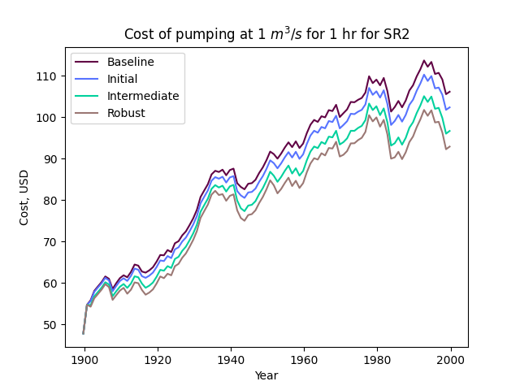
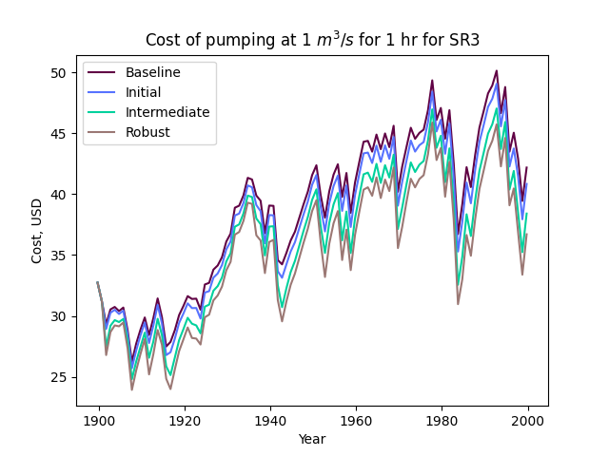
Metric: Pumping Cost

Slide 9
Moving Forward Plan
Interpretation of results
SGMA integration
Final report
Final presentation/showcase
Notes:
Moving forward we plan to compile tables analyzing DIFFERENT STATISTICS PREVIOUSLY MENTIONED for the different metrics while incorporating SGMAs 6 criteria into our analysis. We have started our final report with completing assignment 1 and plan to start our poster in a few weeks prepare for the final presentation.

Slide 10
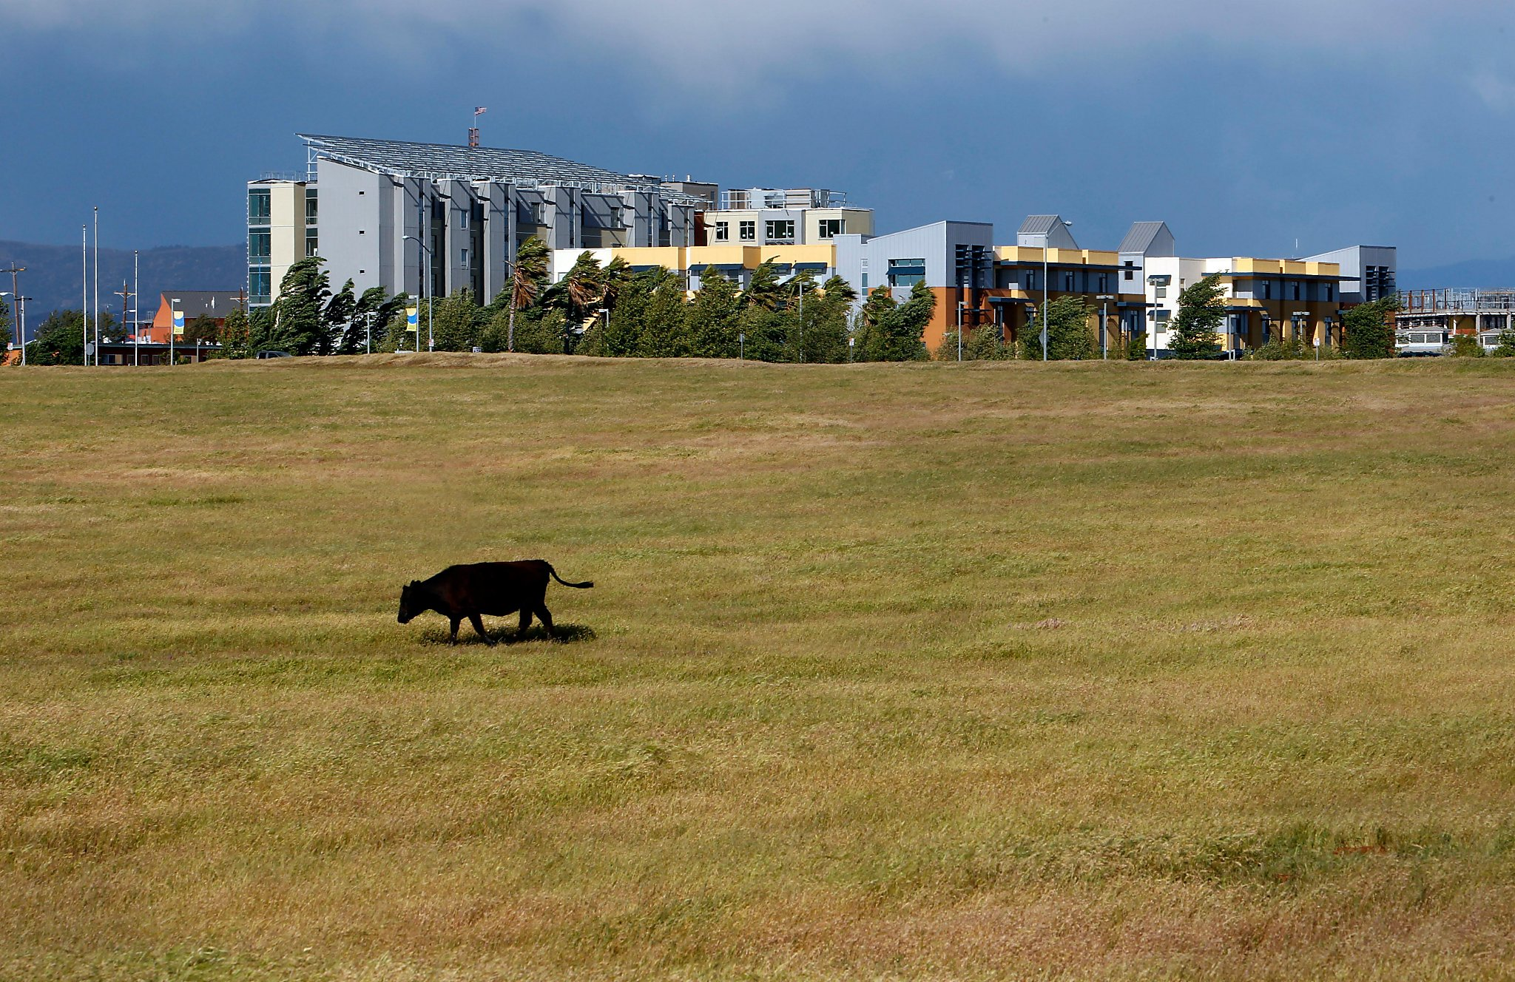
THANK YOU

